Slide 1


Slide 2
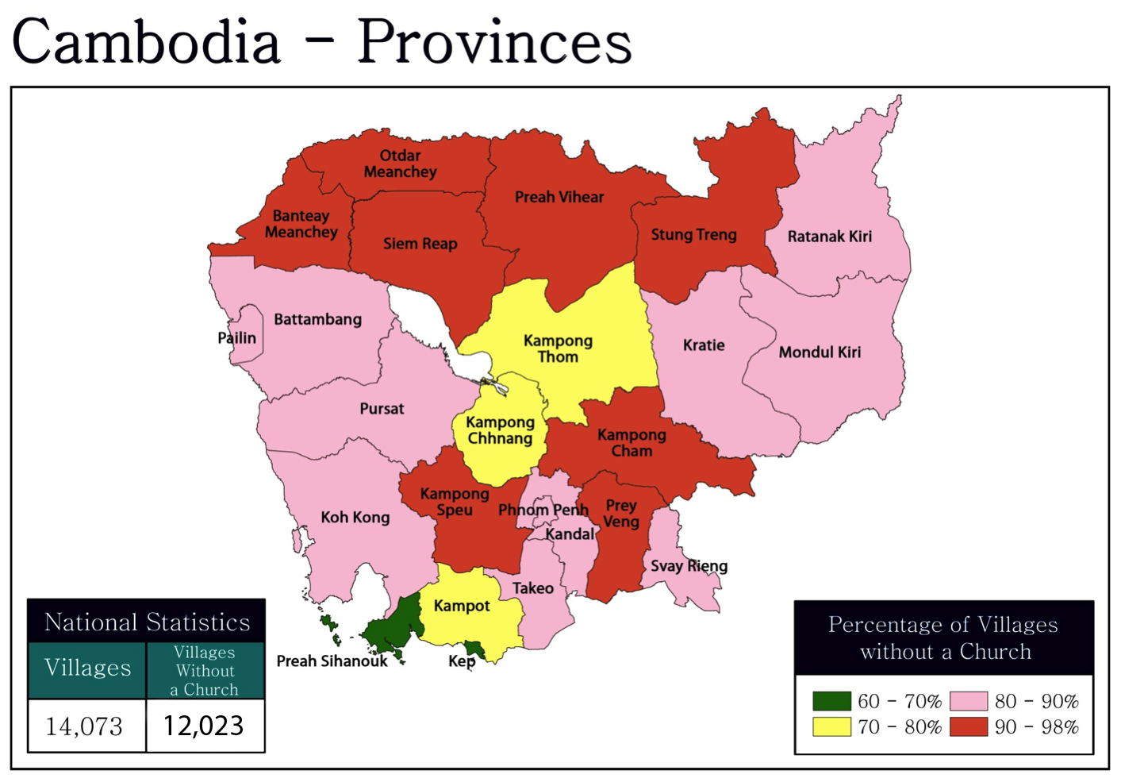

Slide 3
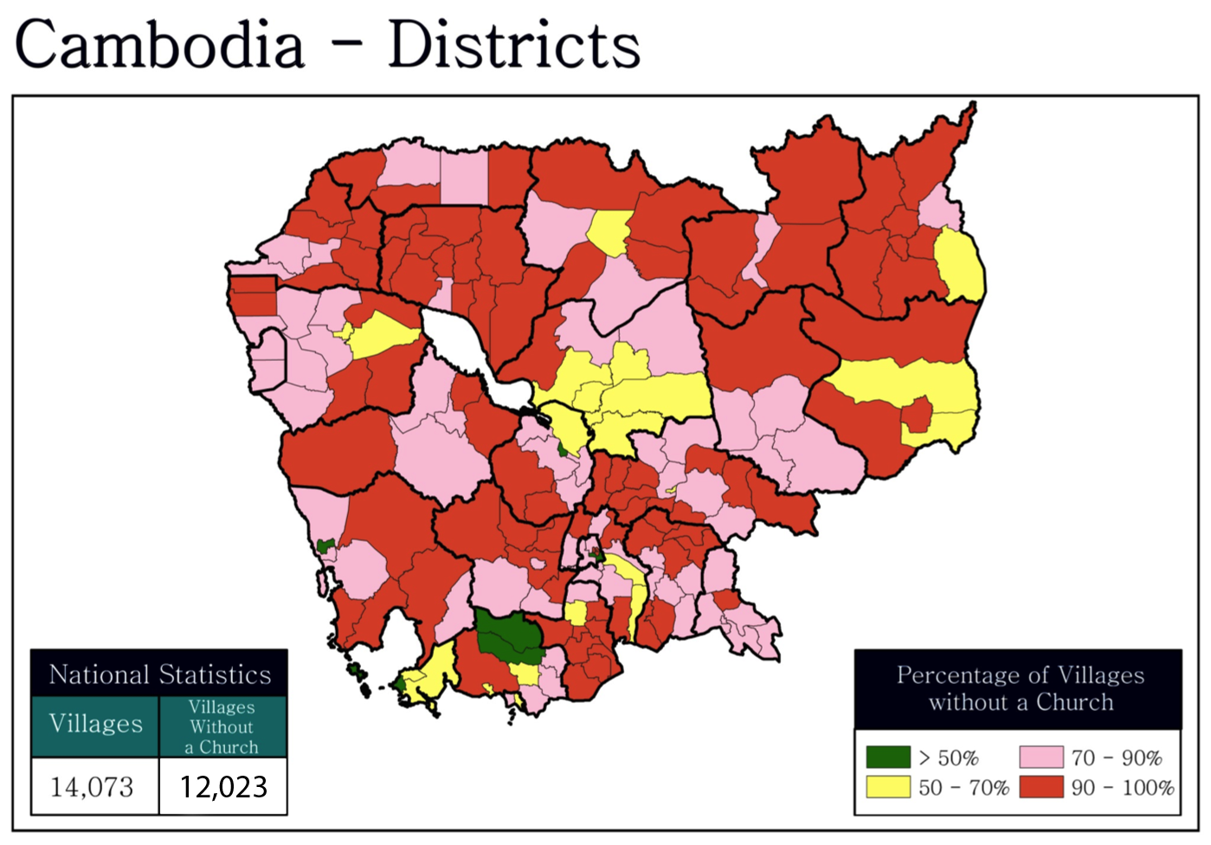

Slide 4
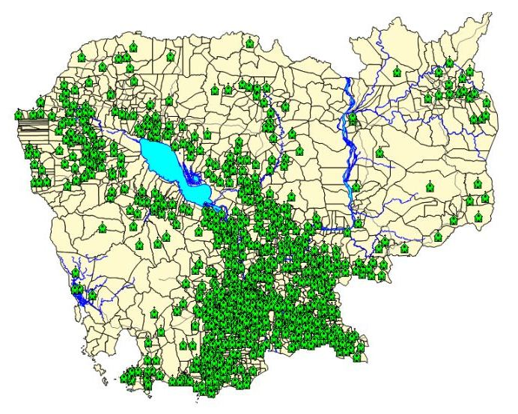
Church Locations by Communes Level

Slide 5
National Church Statistics
Number of Districts | 193
Districts with a church | 180
Districts without a church | 13
Number of Communes | 1,621
Communes with a church | 904
Communes without a church | 717
Number of Villages | 14,073
Villages with a church | 2,050
Villages without a church | 12,023
Number of Churches | 2,589
Number of Christians | 131,618
Percentage of Christians | 0.98%

Slide 6
Percentage of Churches

Slide 7
Number of Churches by Province

Slide 8
Churches by Year Founded

